Slide 1
JPS Board of Trustees
Bond Update
June 3, 2021

Slide 2
Presentation Overview
Construction Updates
Projected Board Action Dates on Remaining Projects
Bond Financial Report Update
Communications Update

Slide 3
Construction Updates
Wilkins
Clausell
Marshall
Oak Forest
Shirley
Brinkley
Chastain
Powell

Slide 4
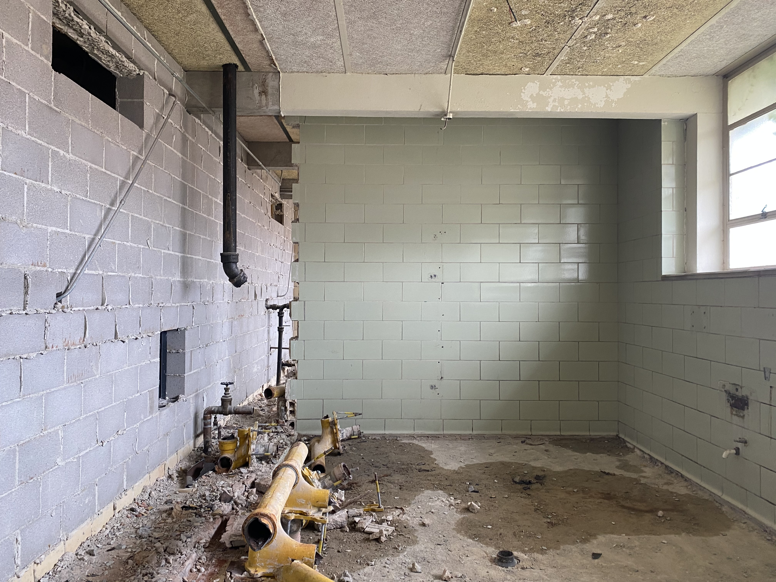
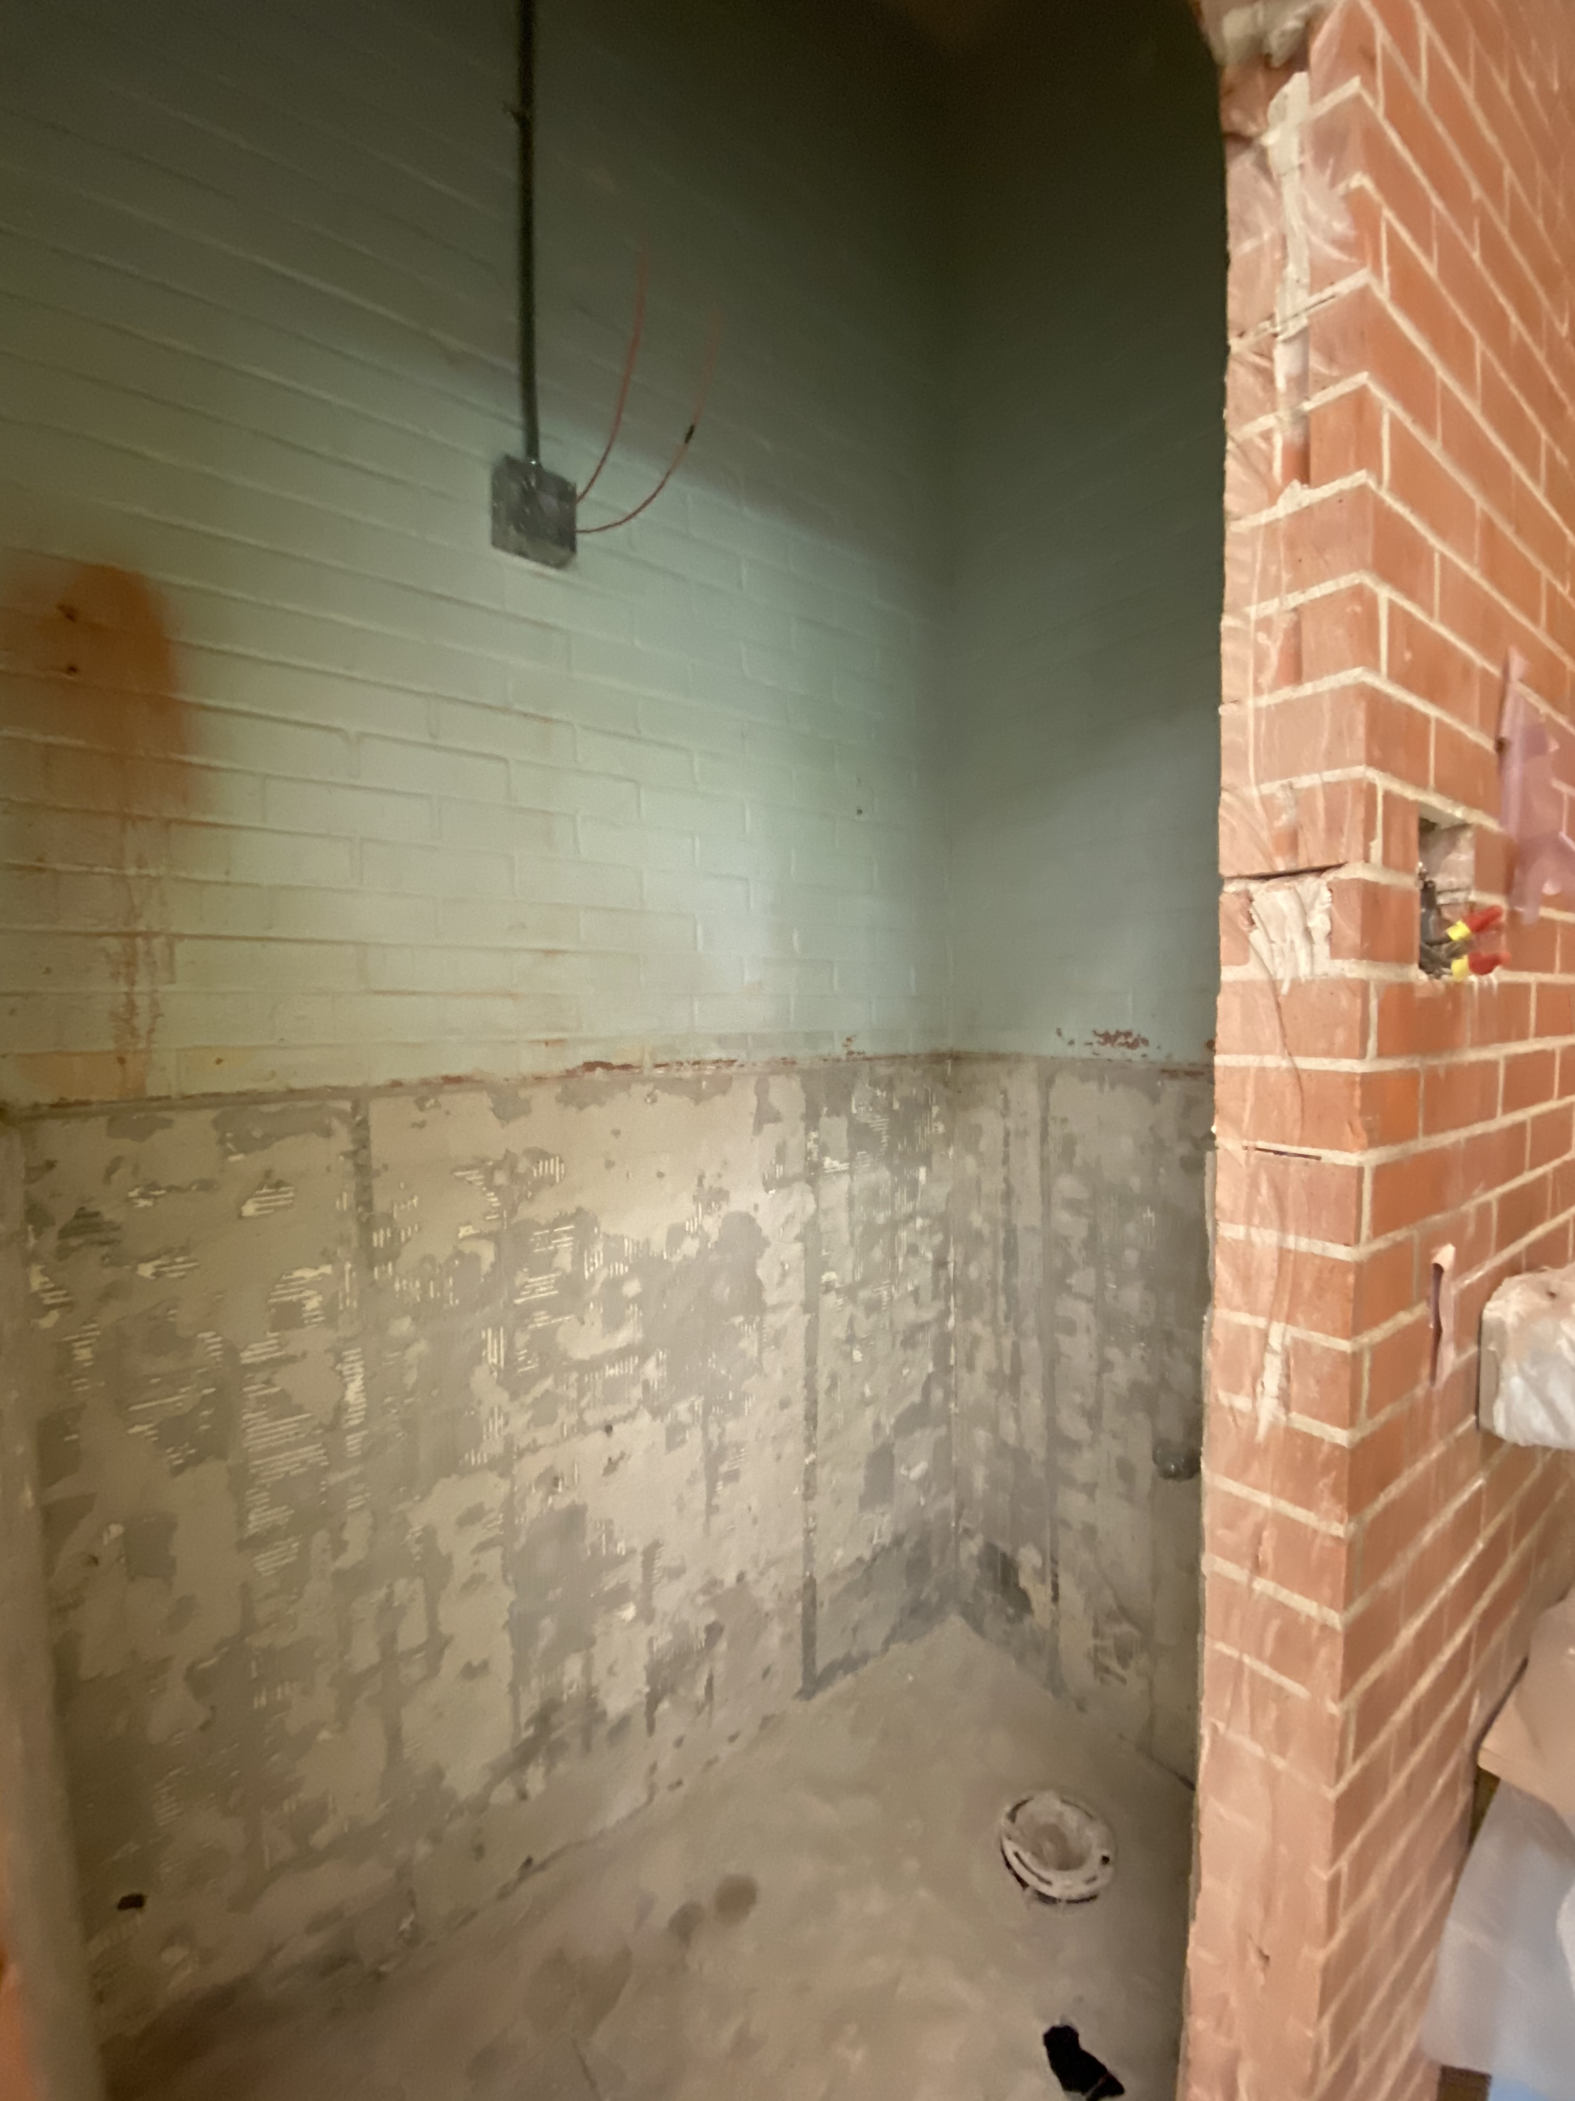
Wilkins Elementary School
Restroom Renovations

Slide 5
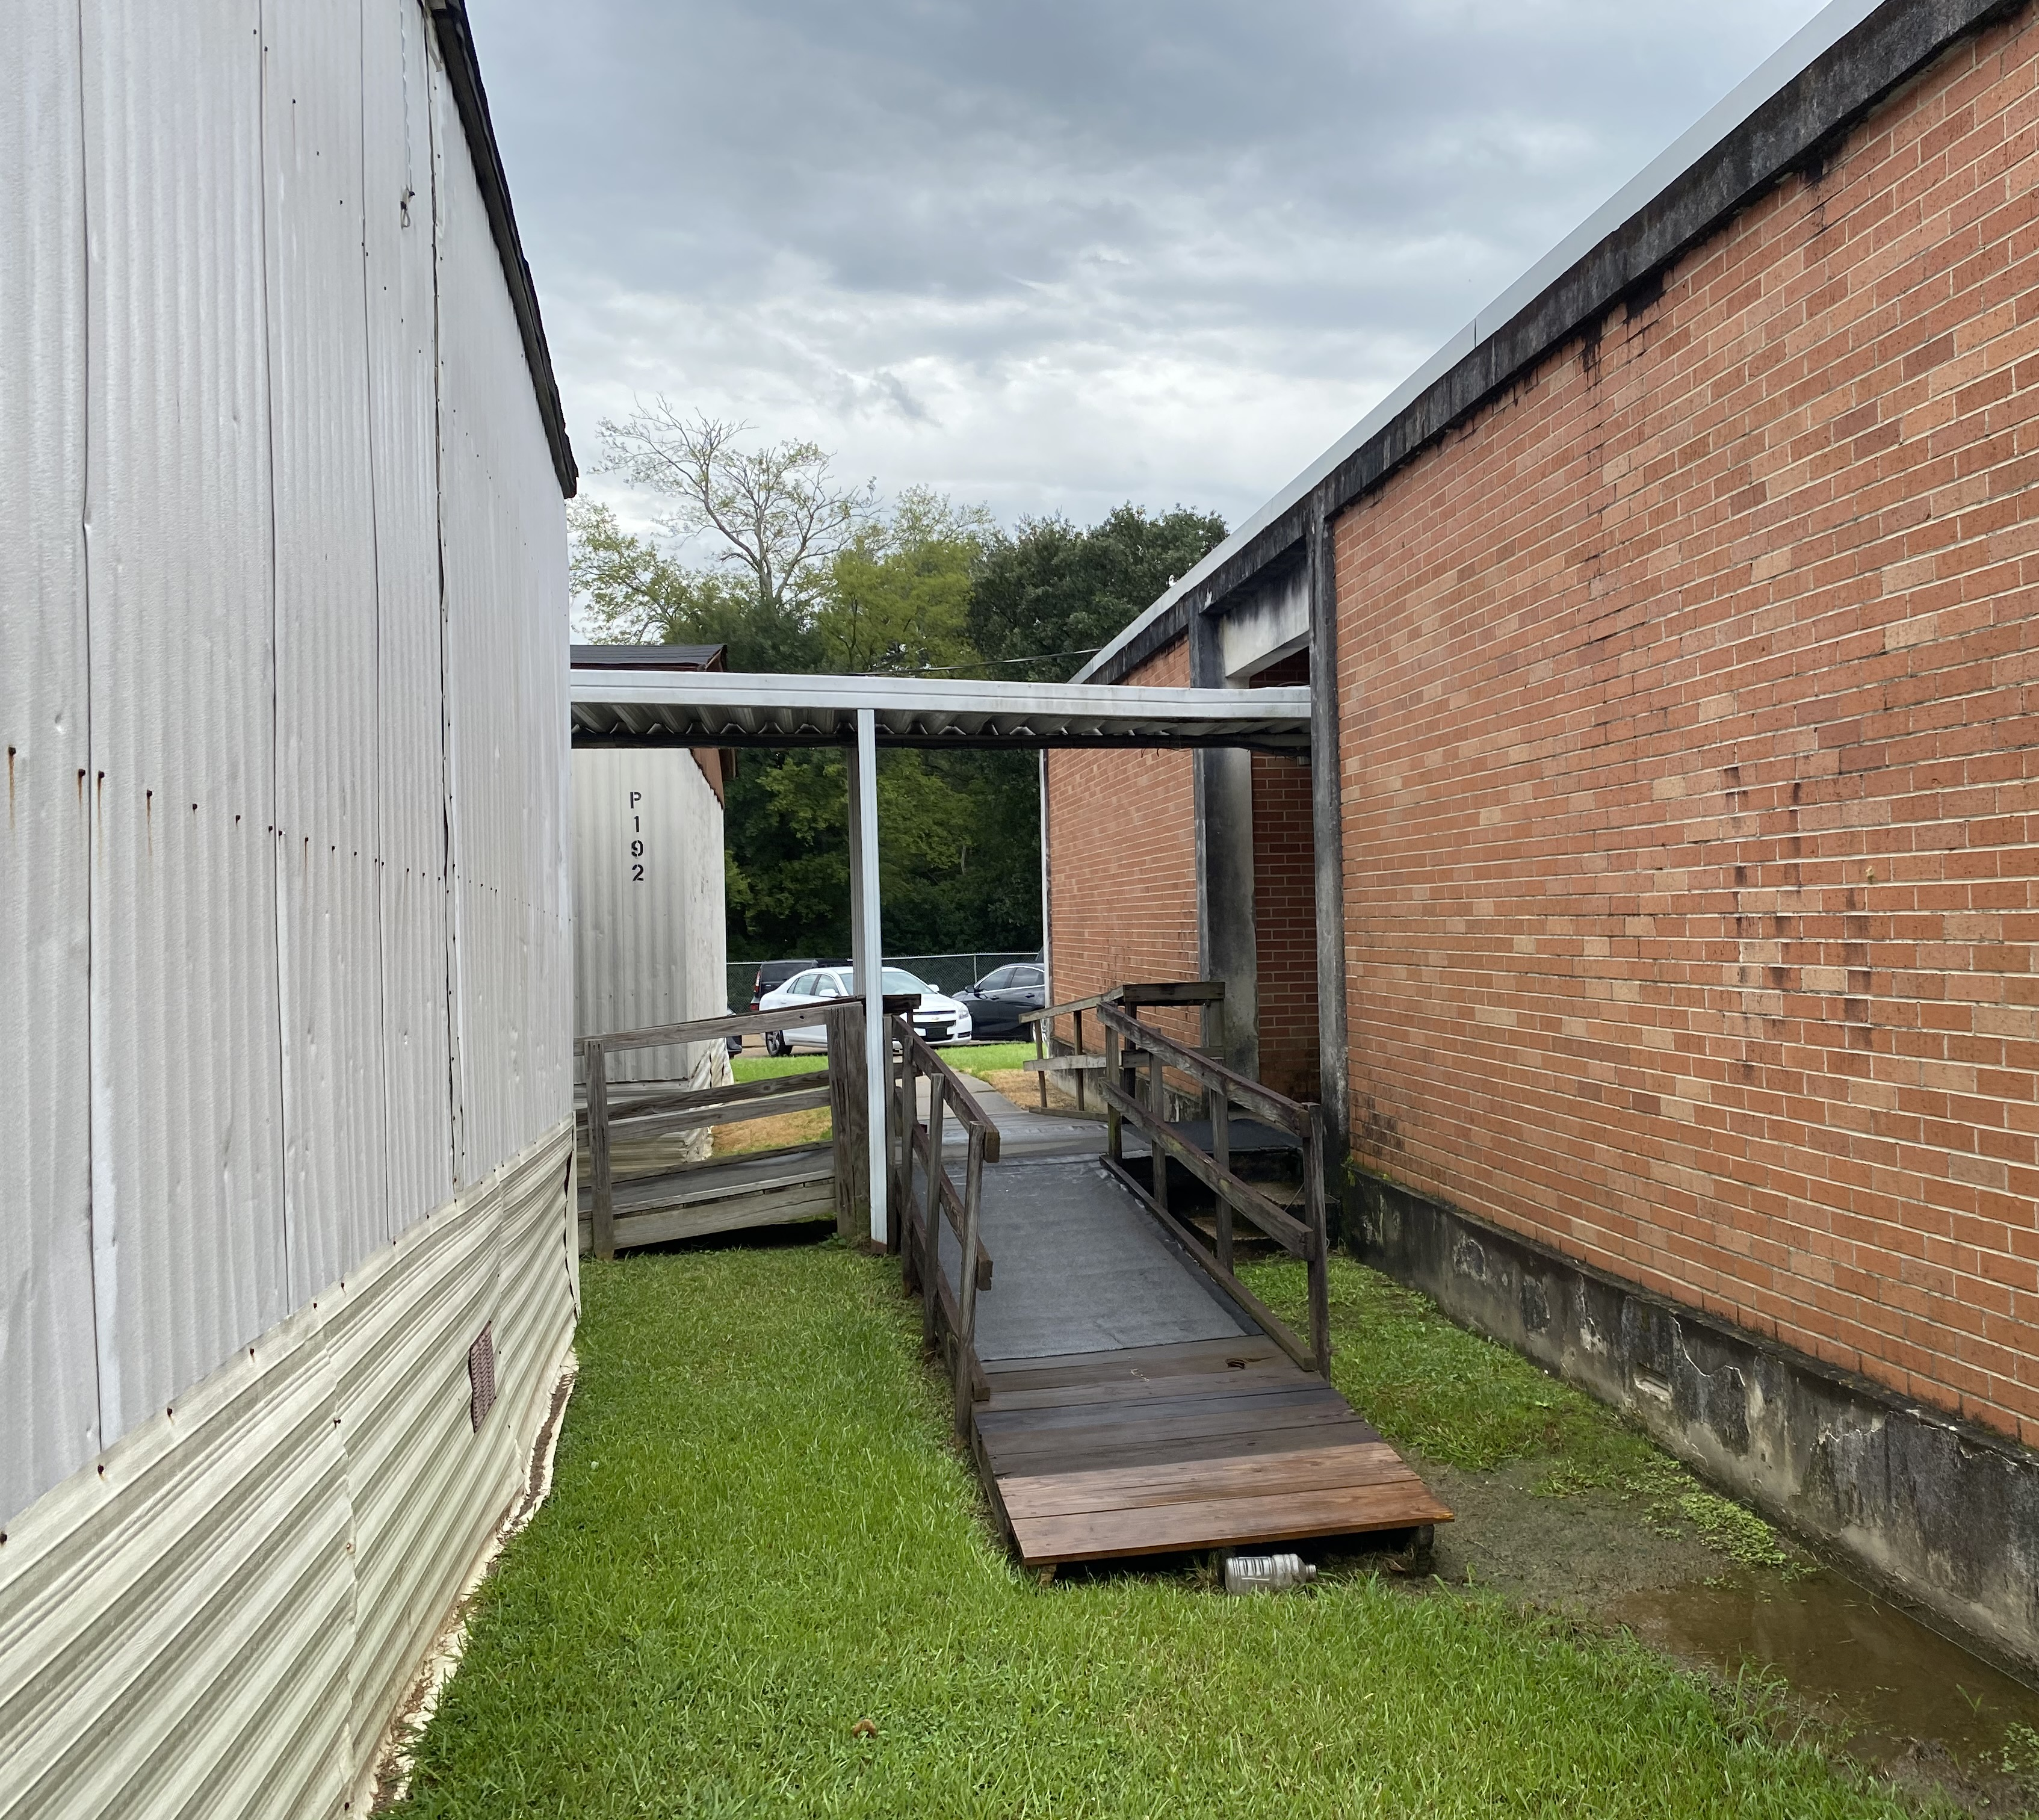
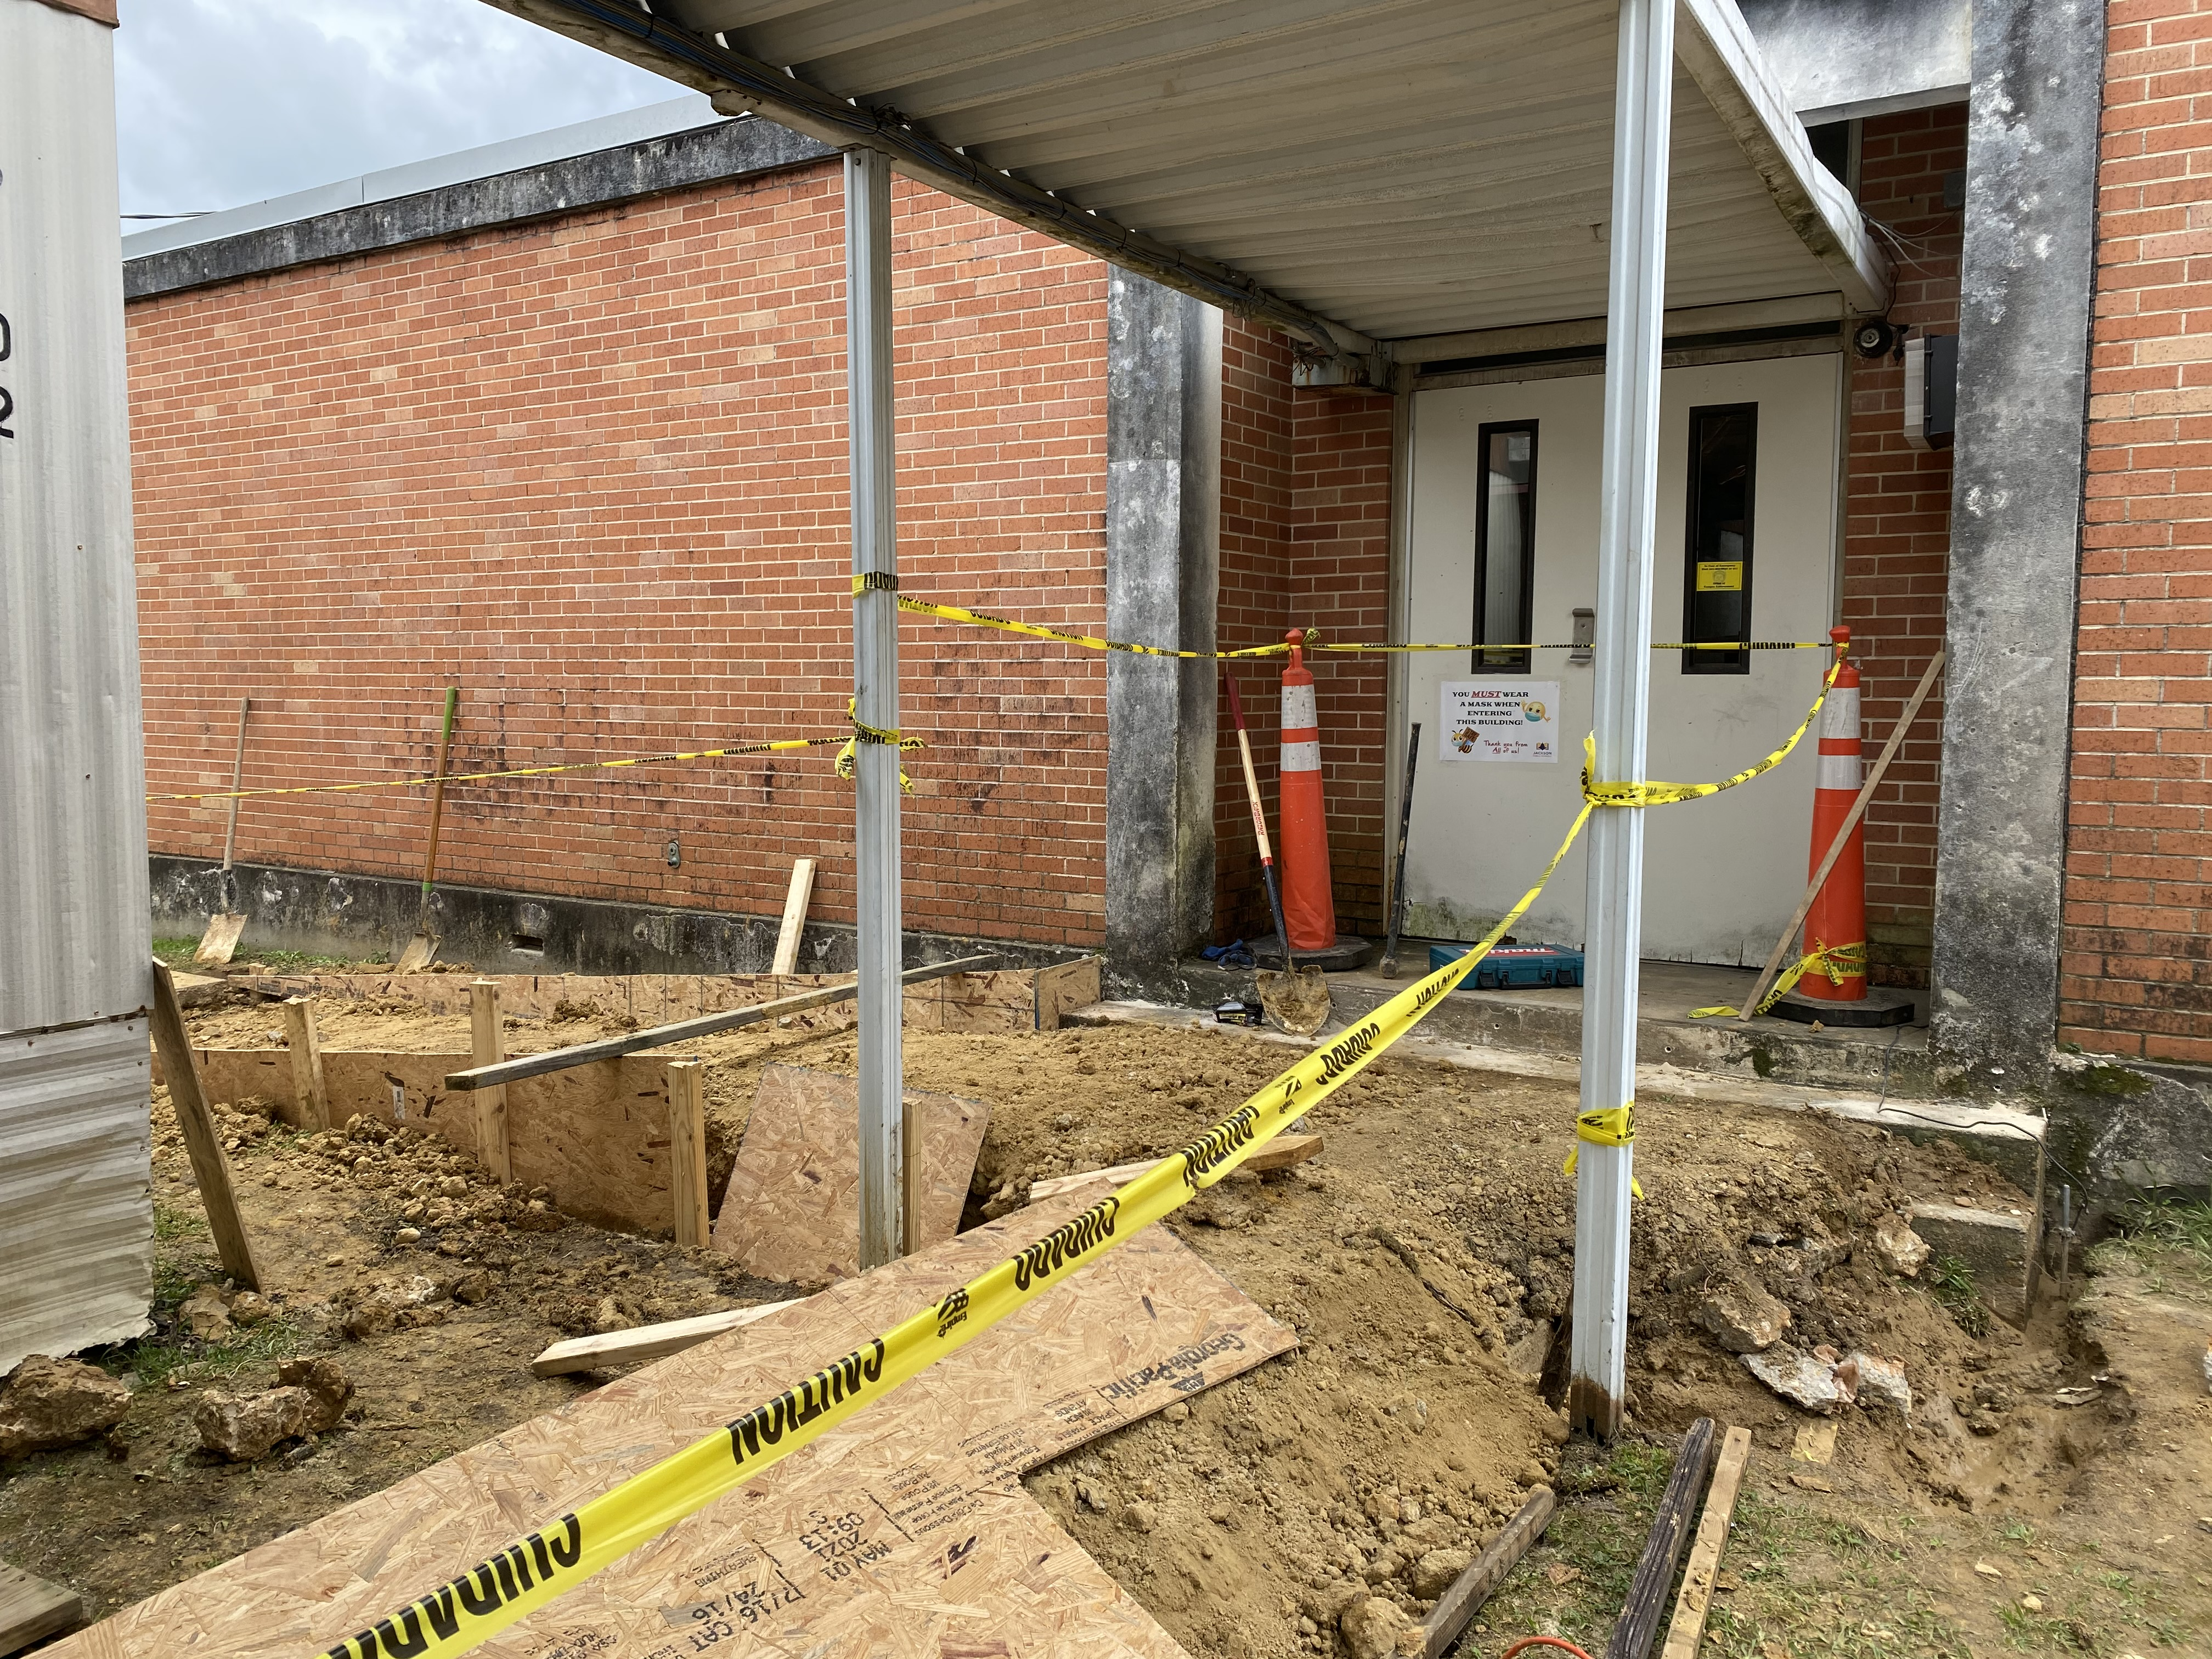
Clausell Elementary School
ADA Improvements

Slide 6
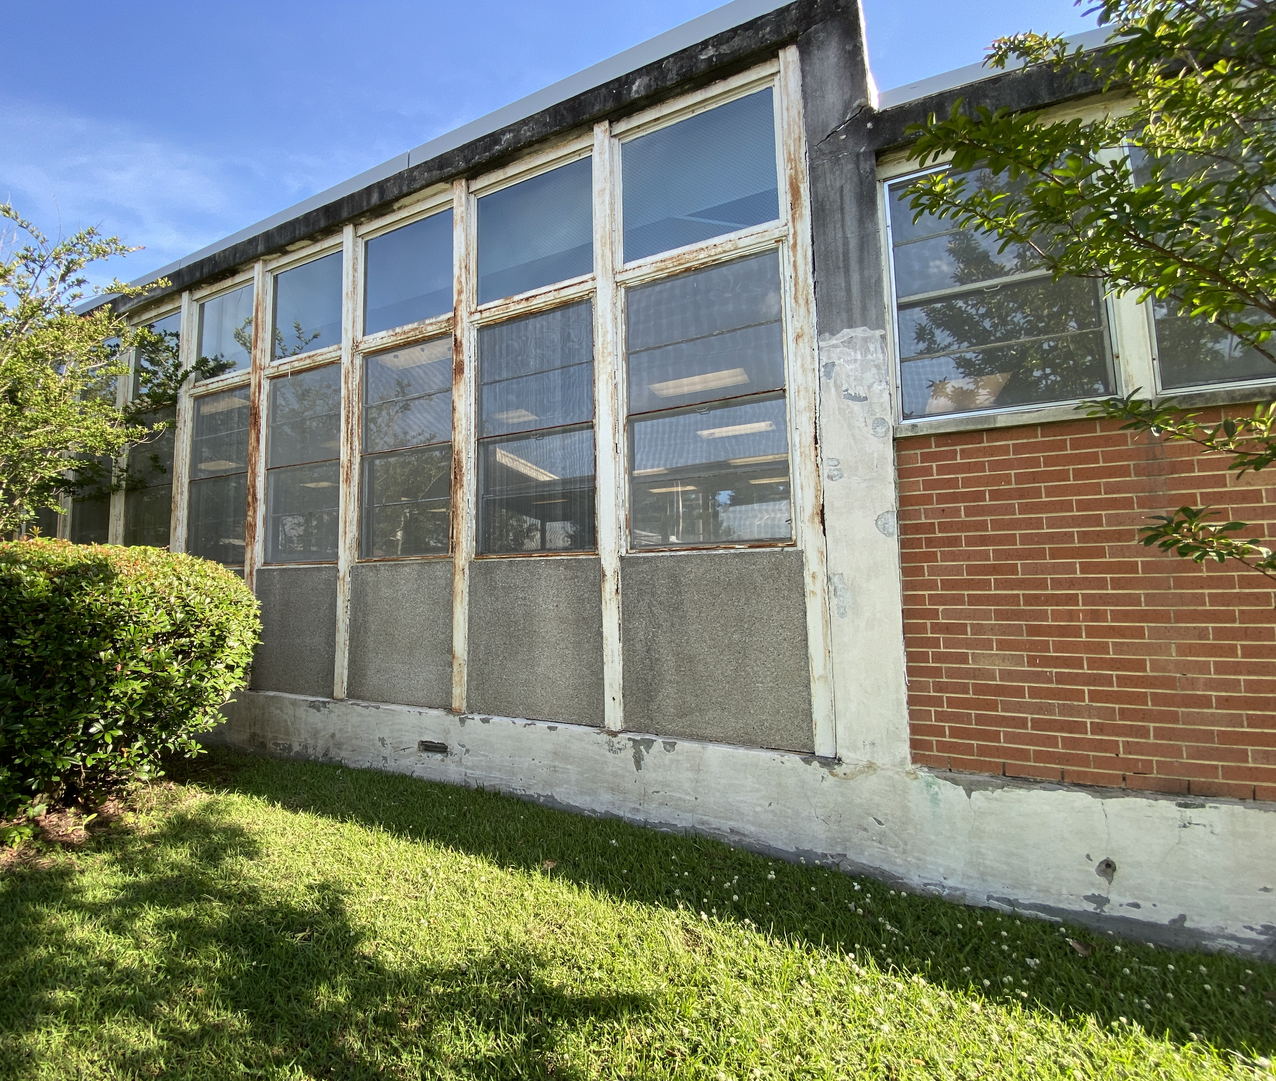
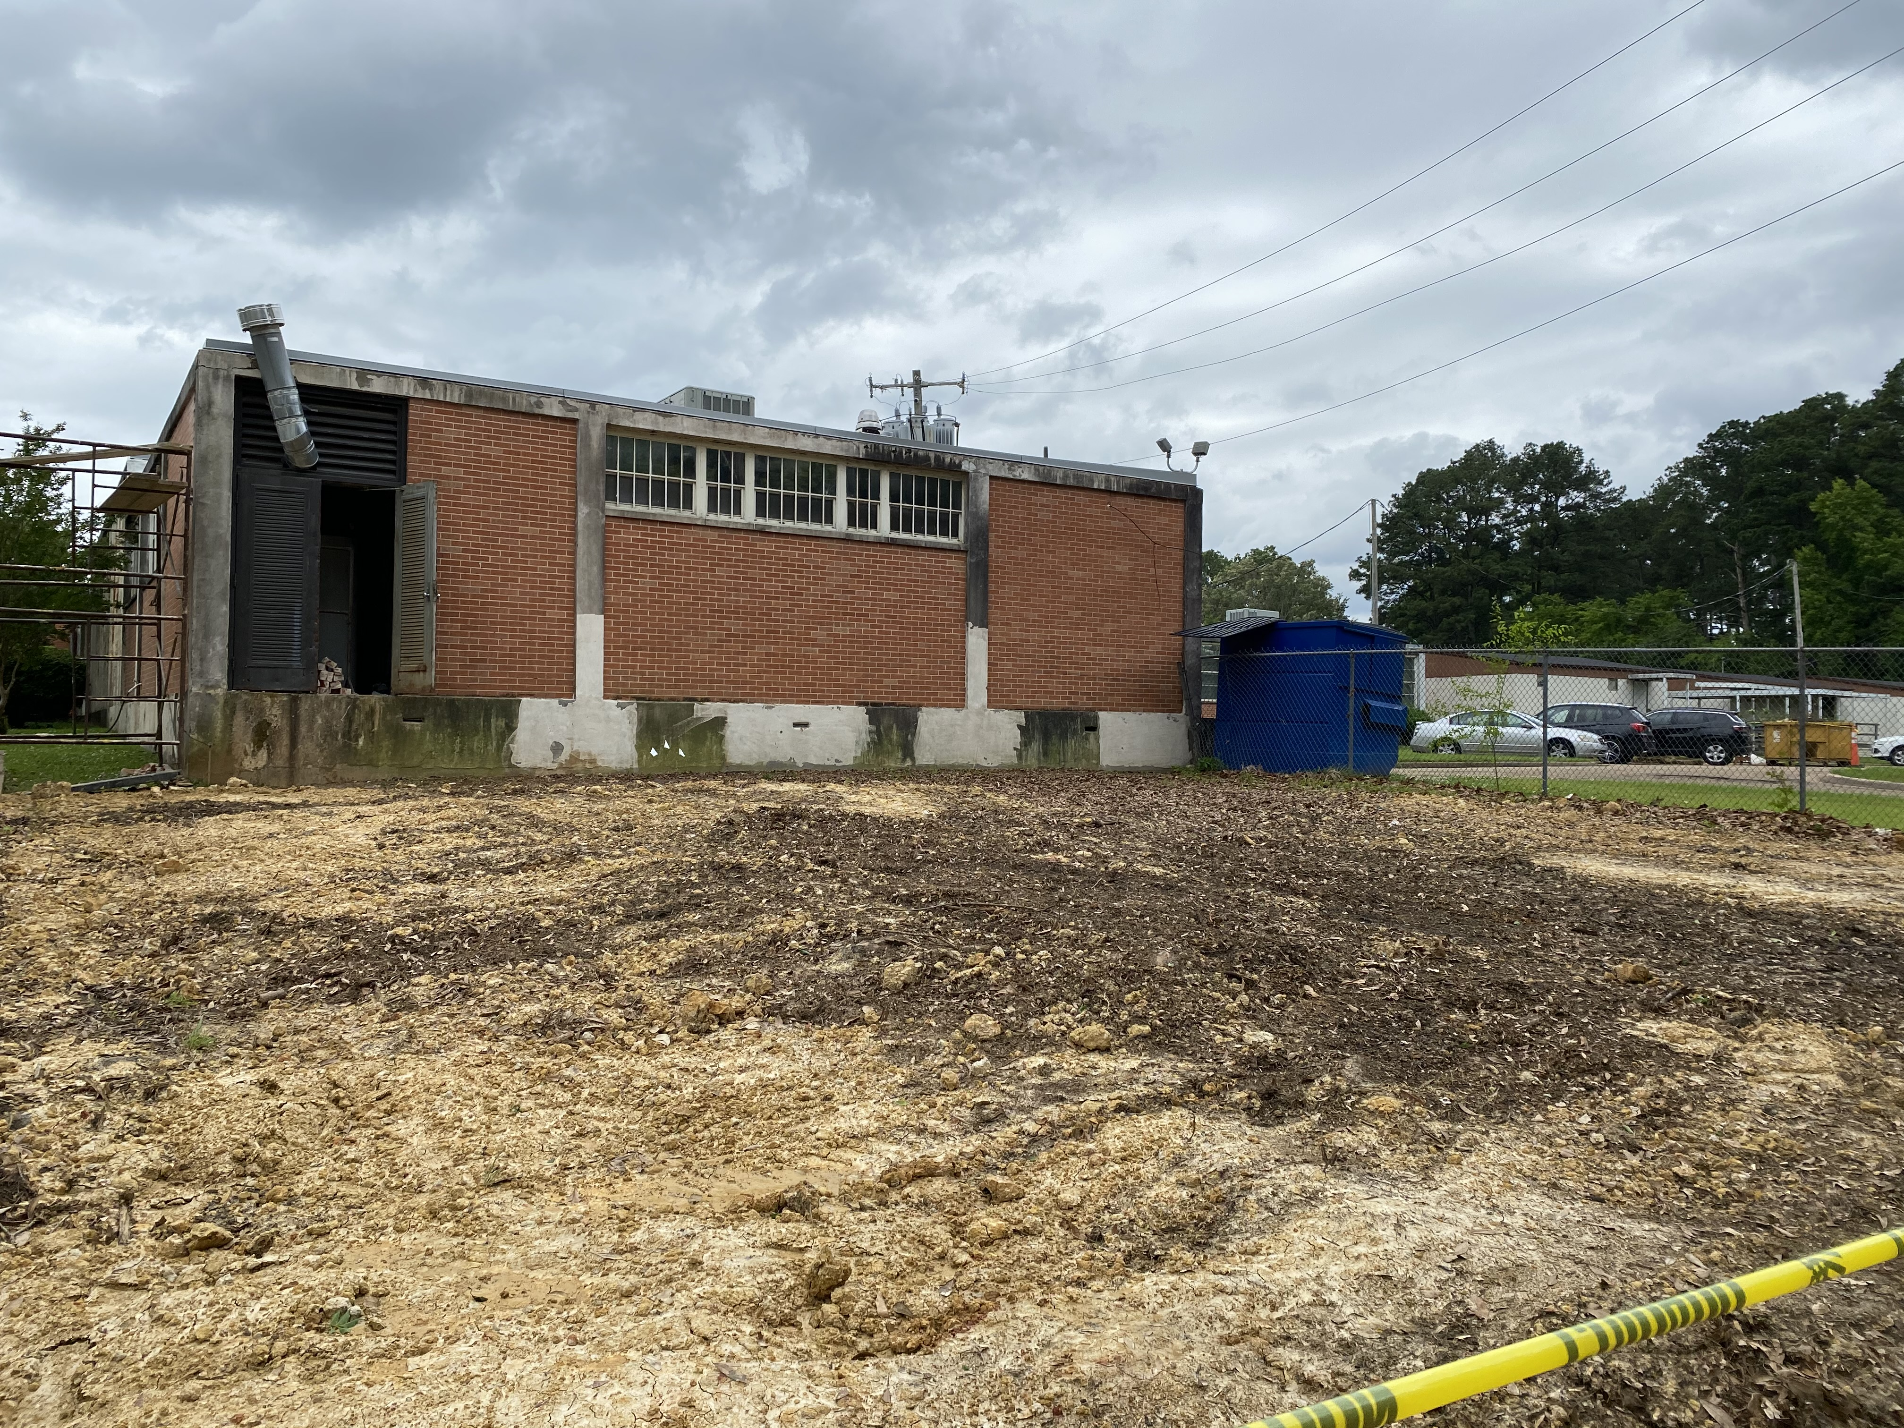
Clausell Elementary School
Site Improvements

Slide 7
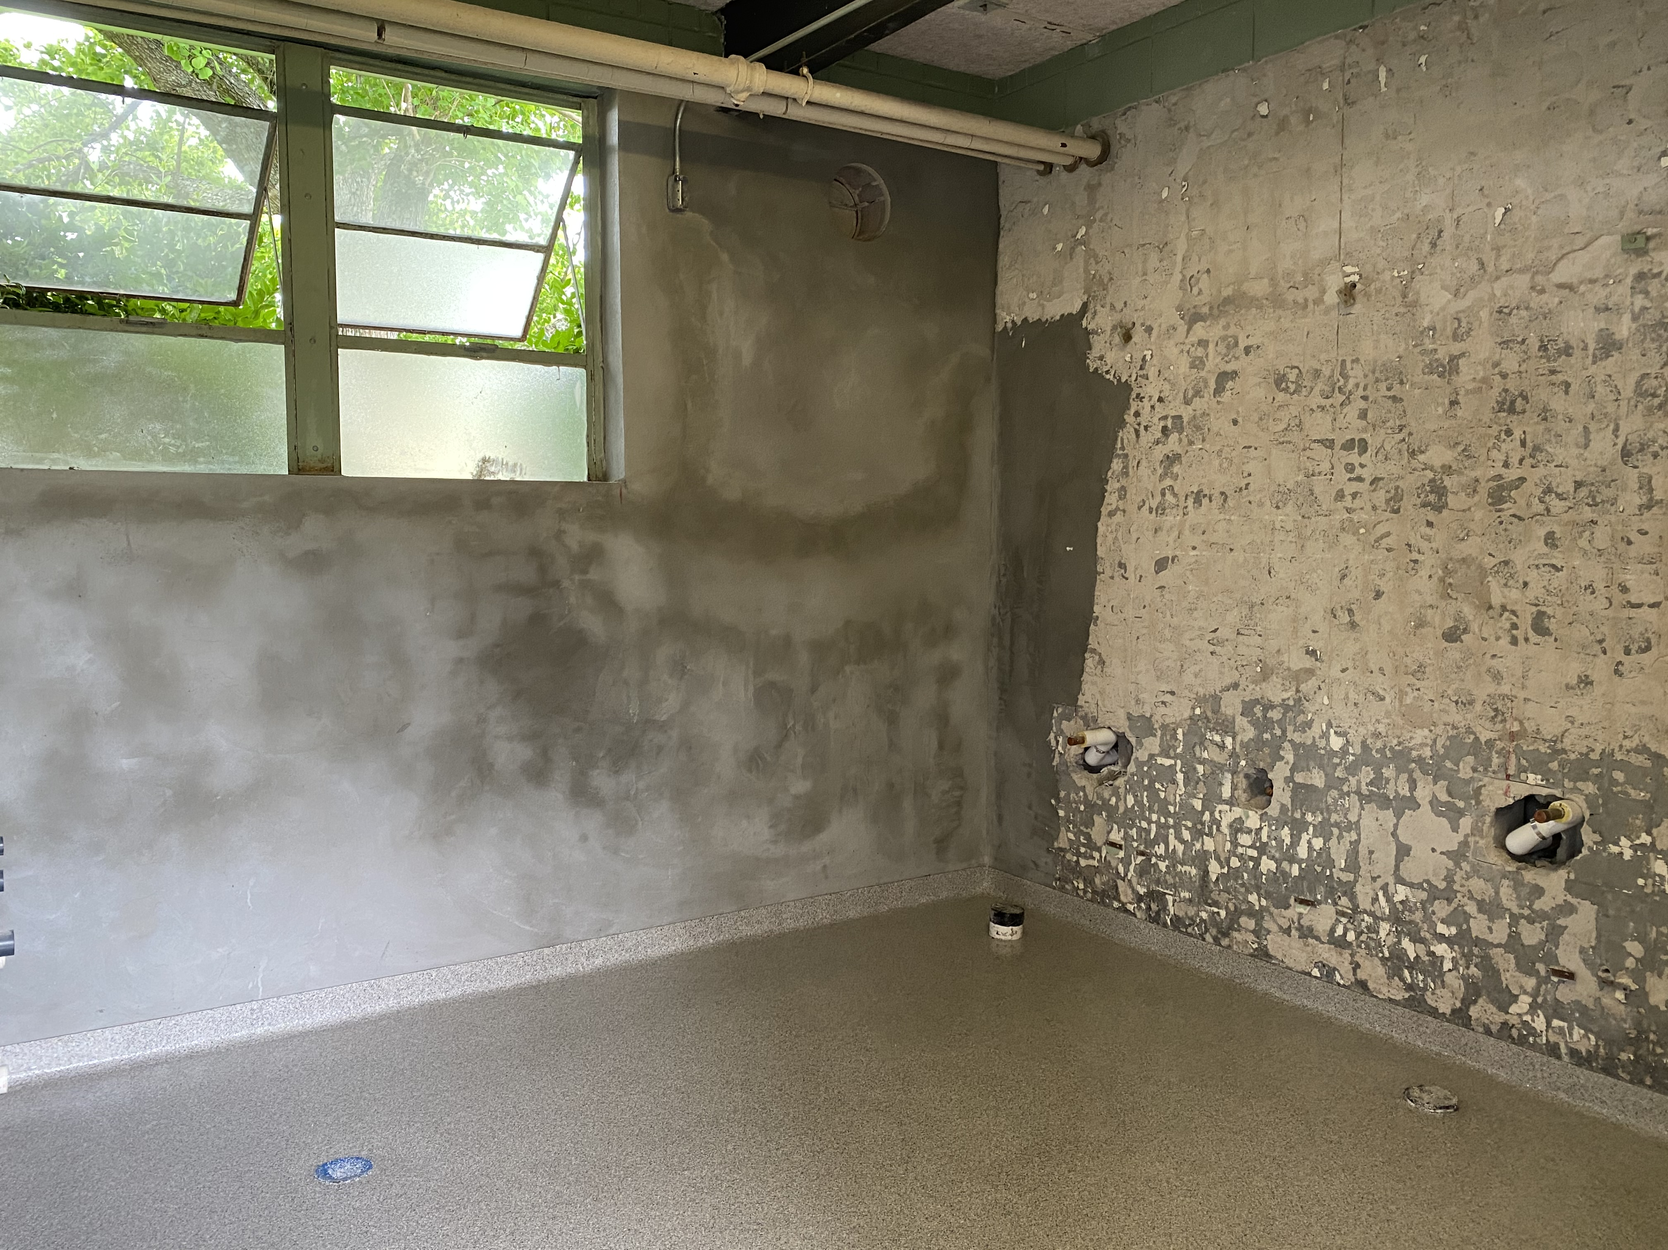
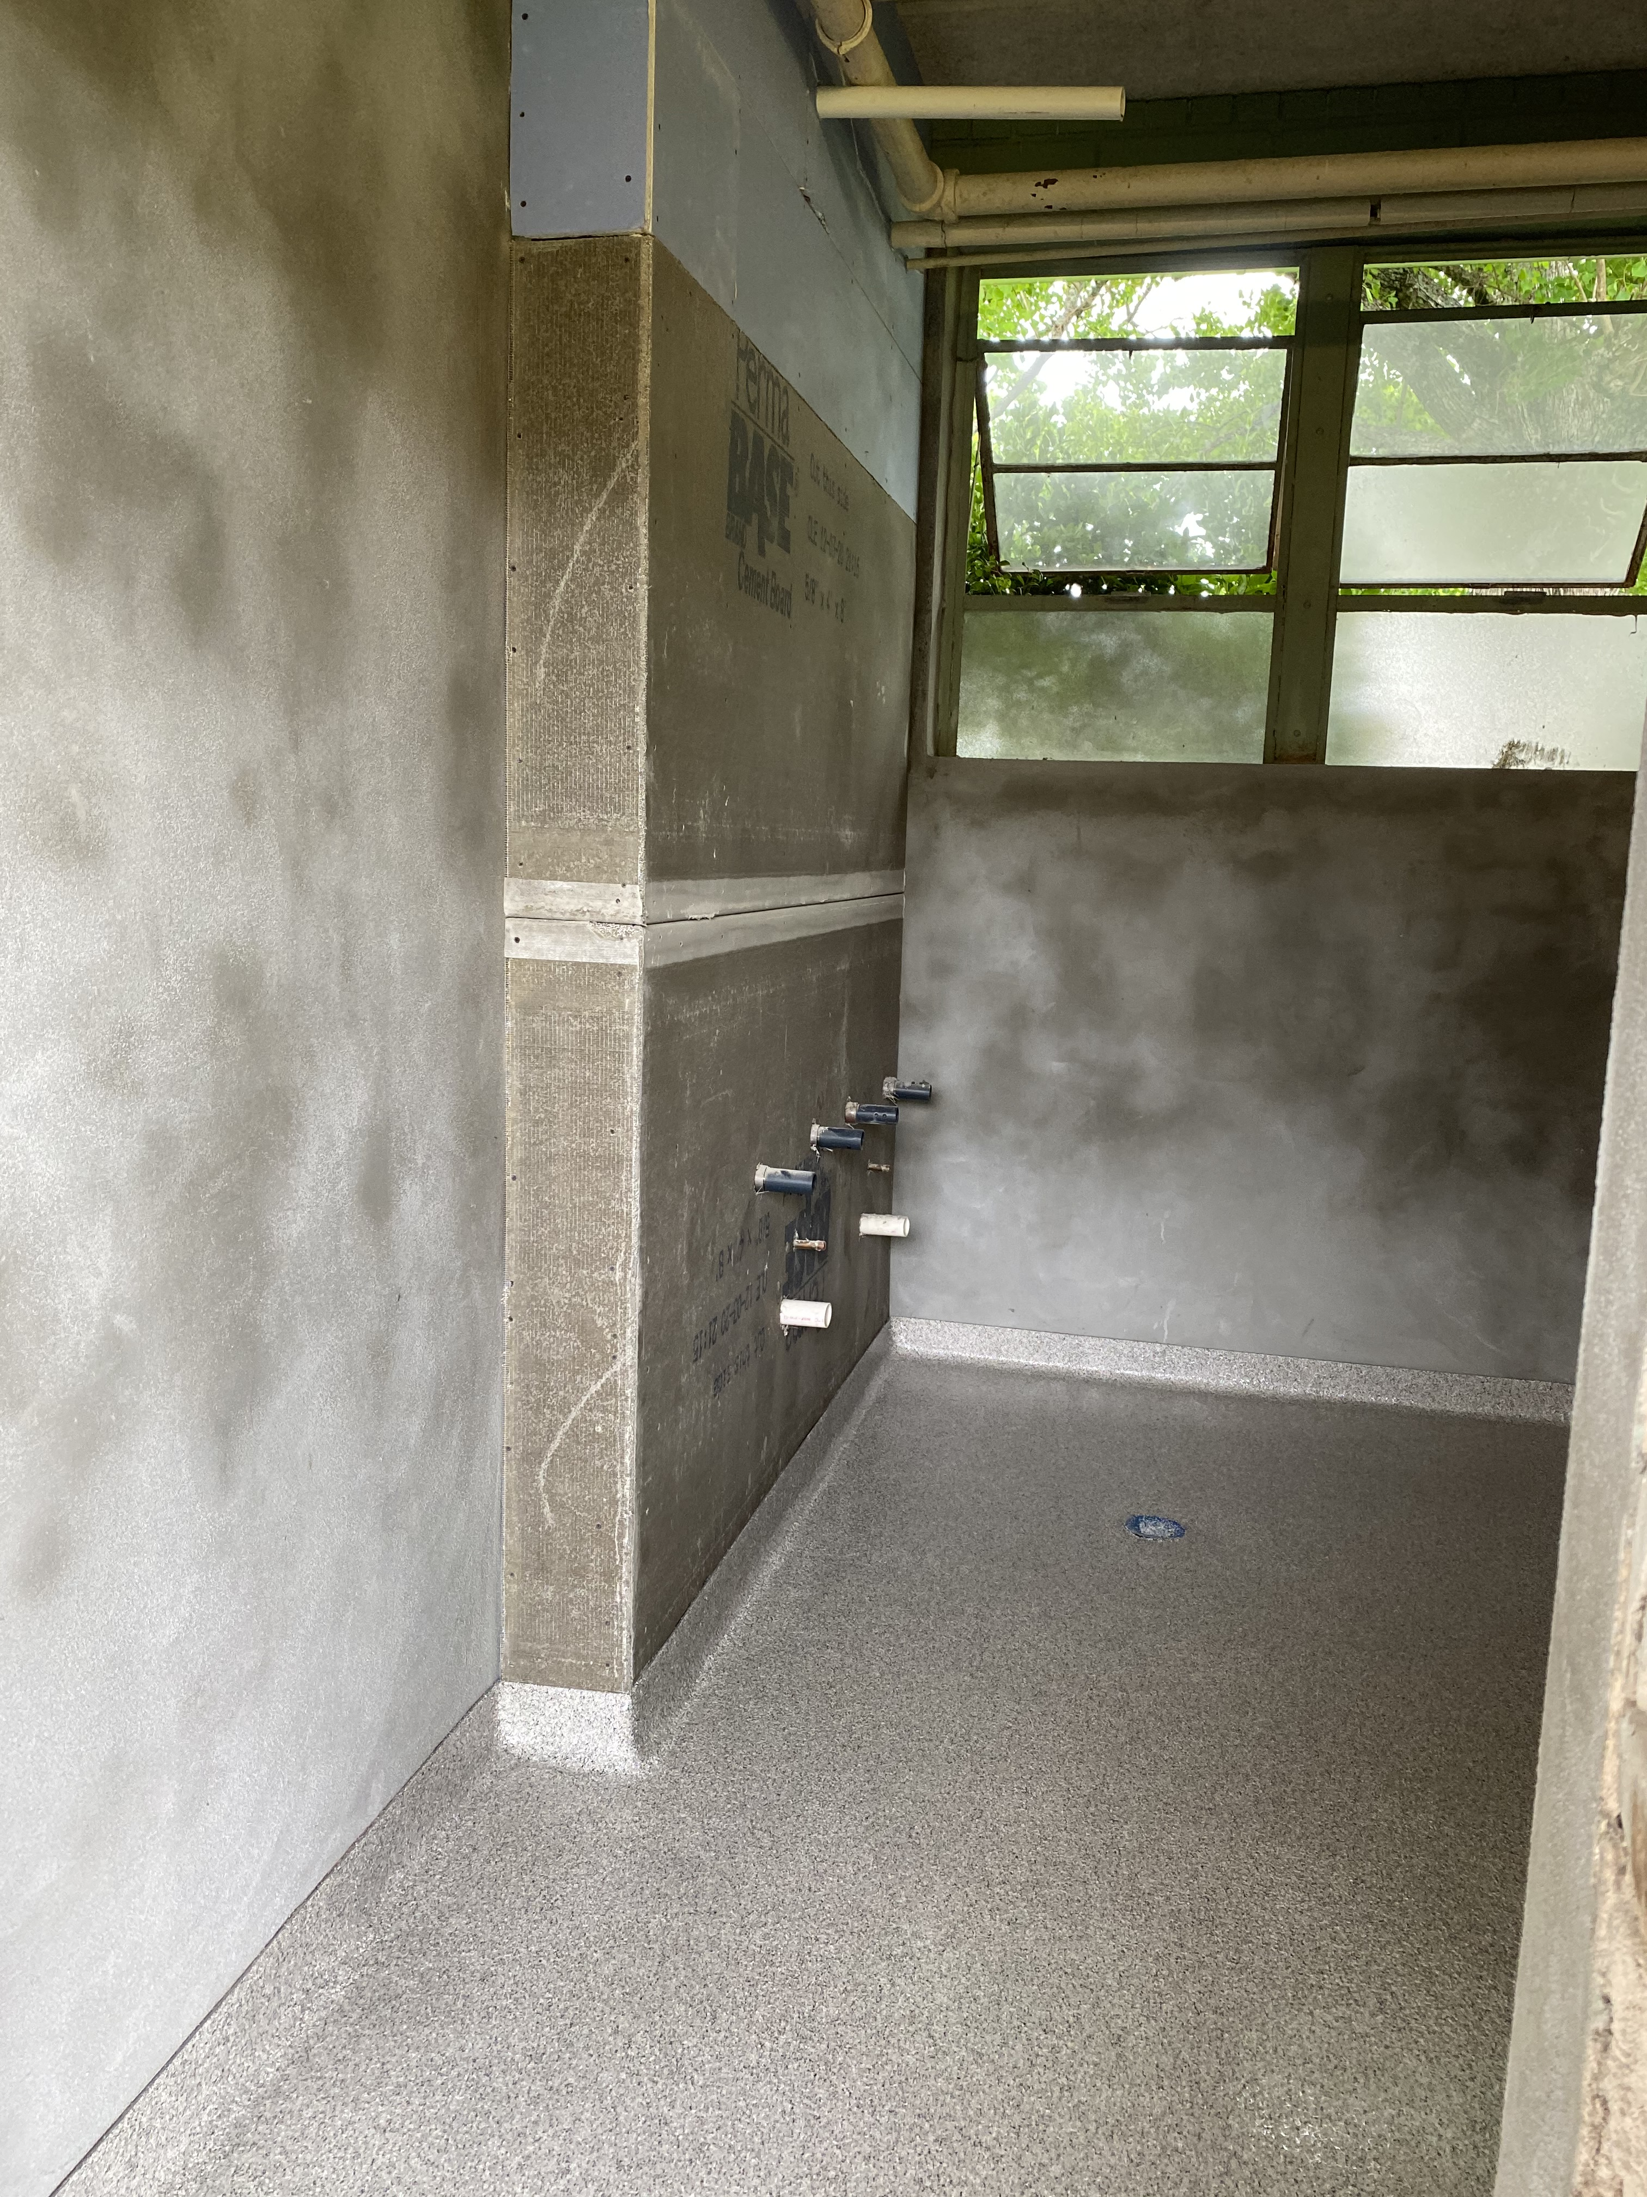
Marshall Elementary School
Restroom Renovations

Slide 8
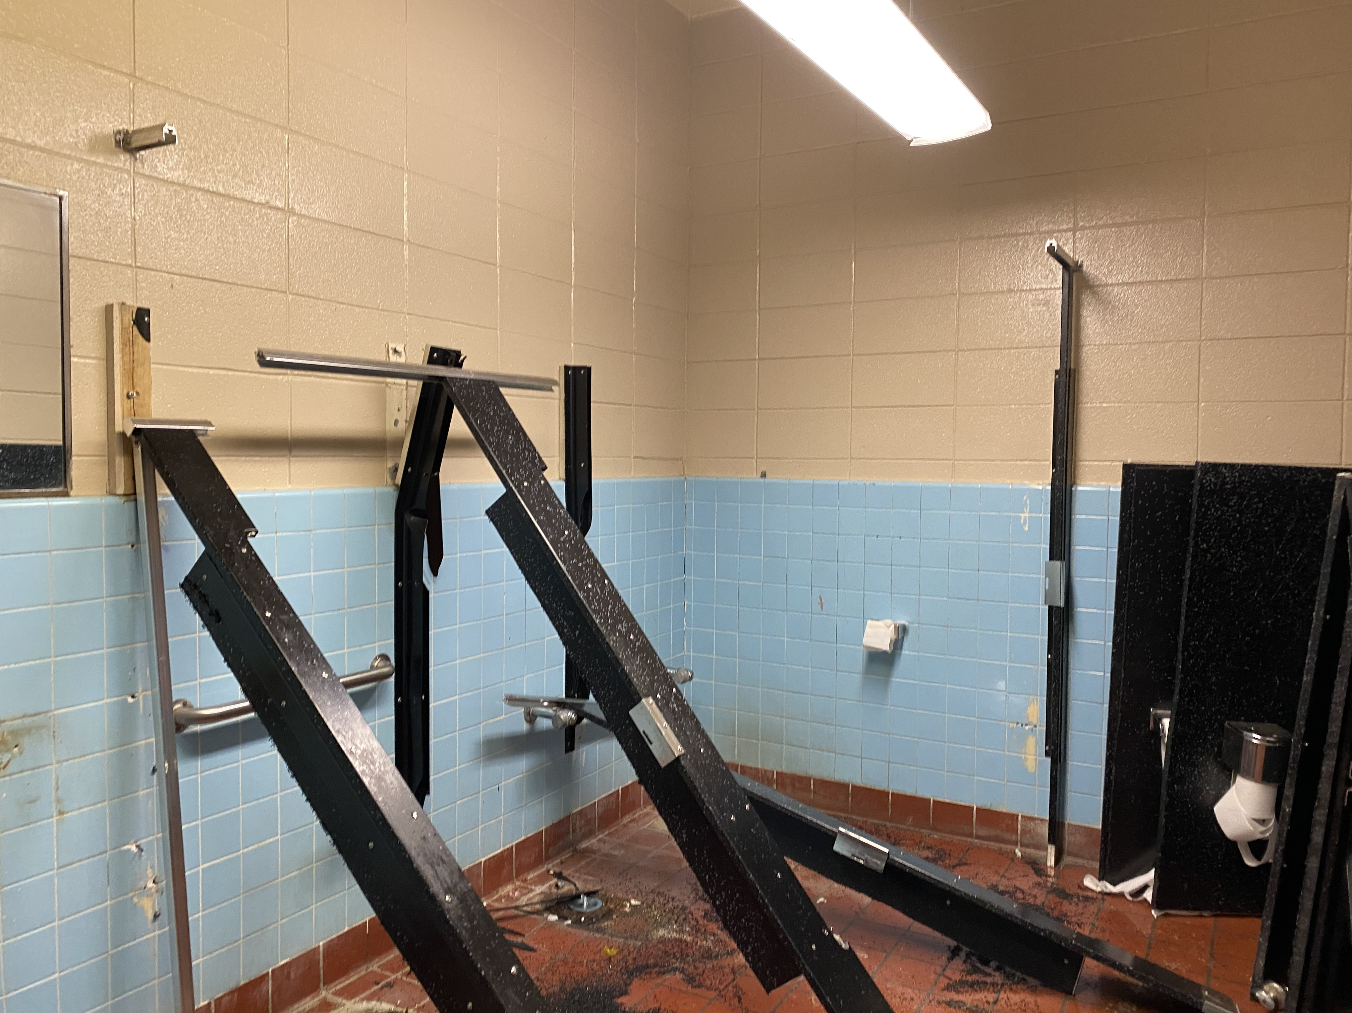
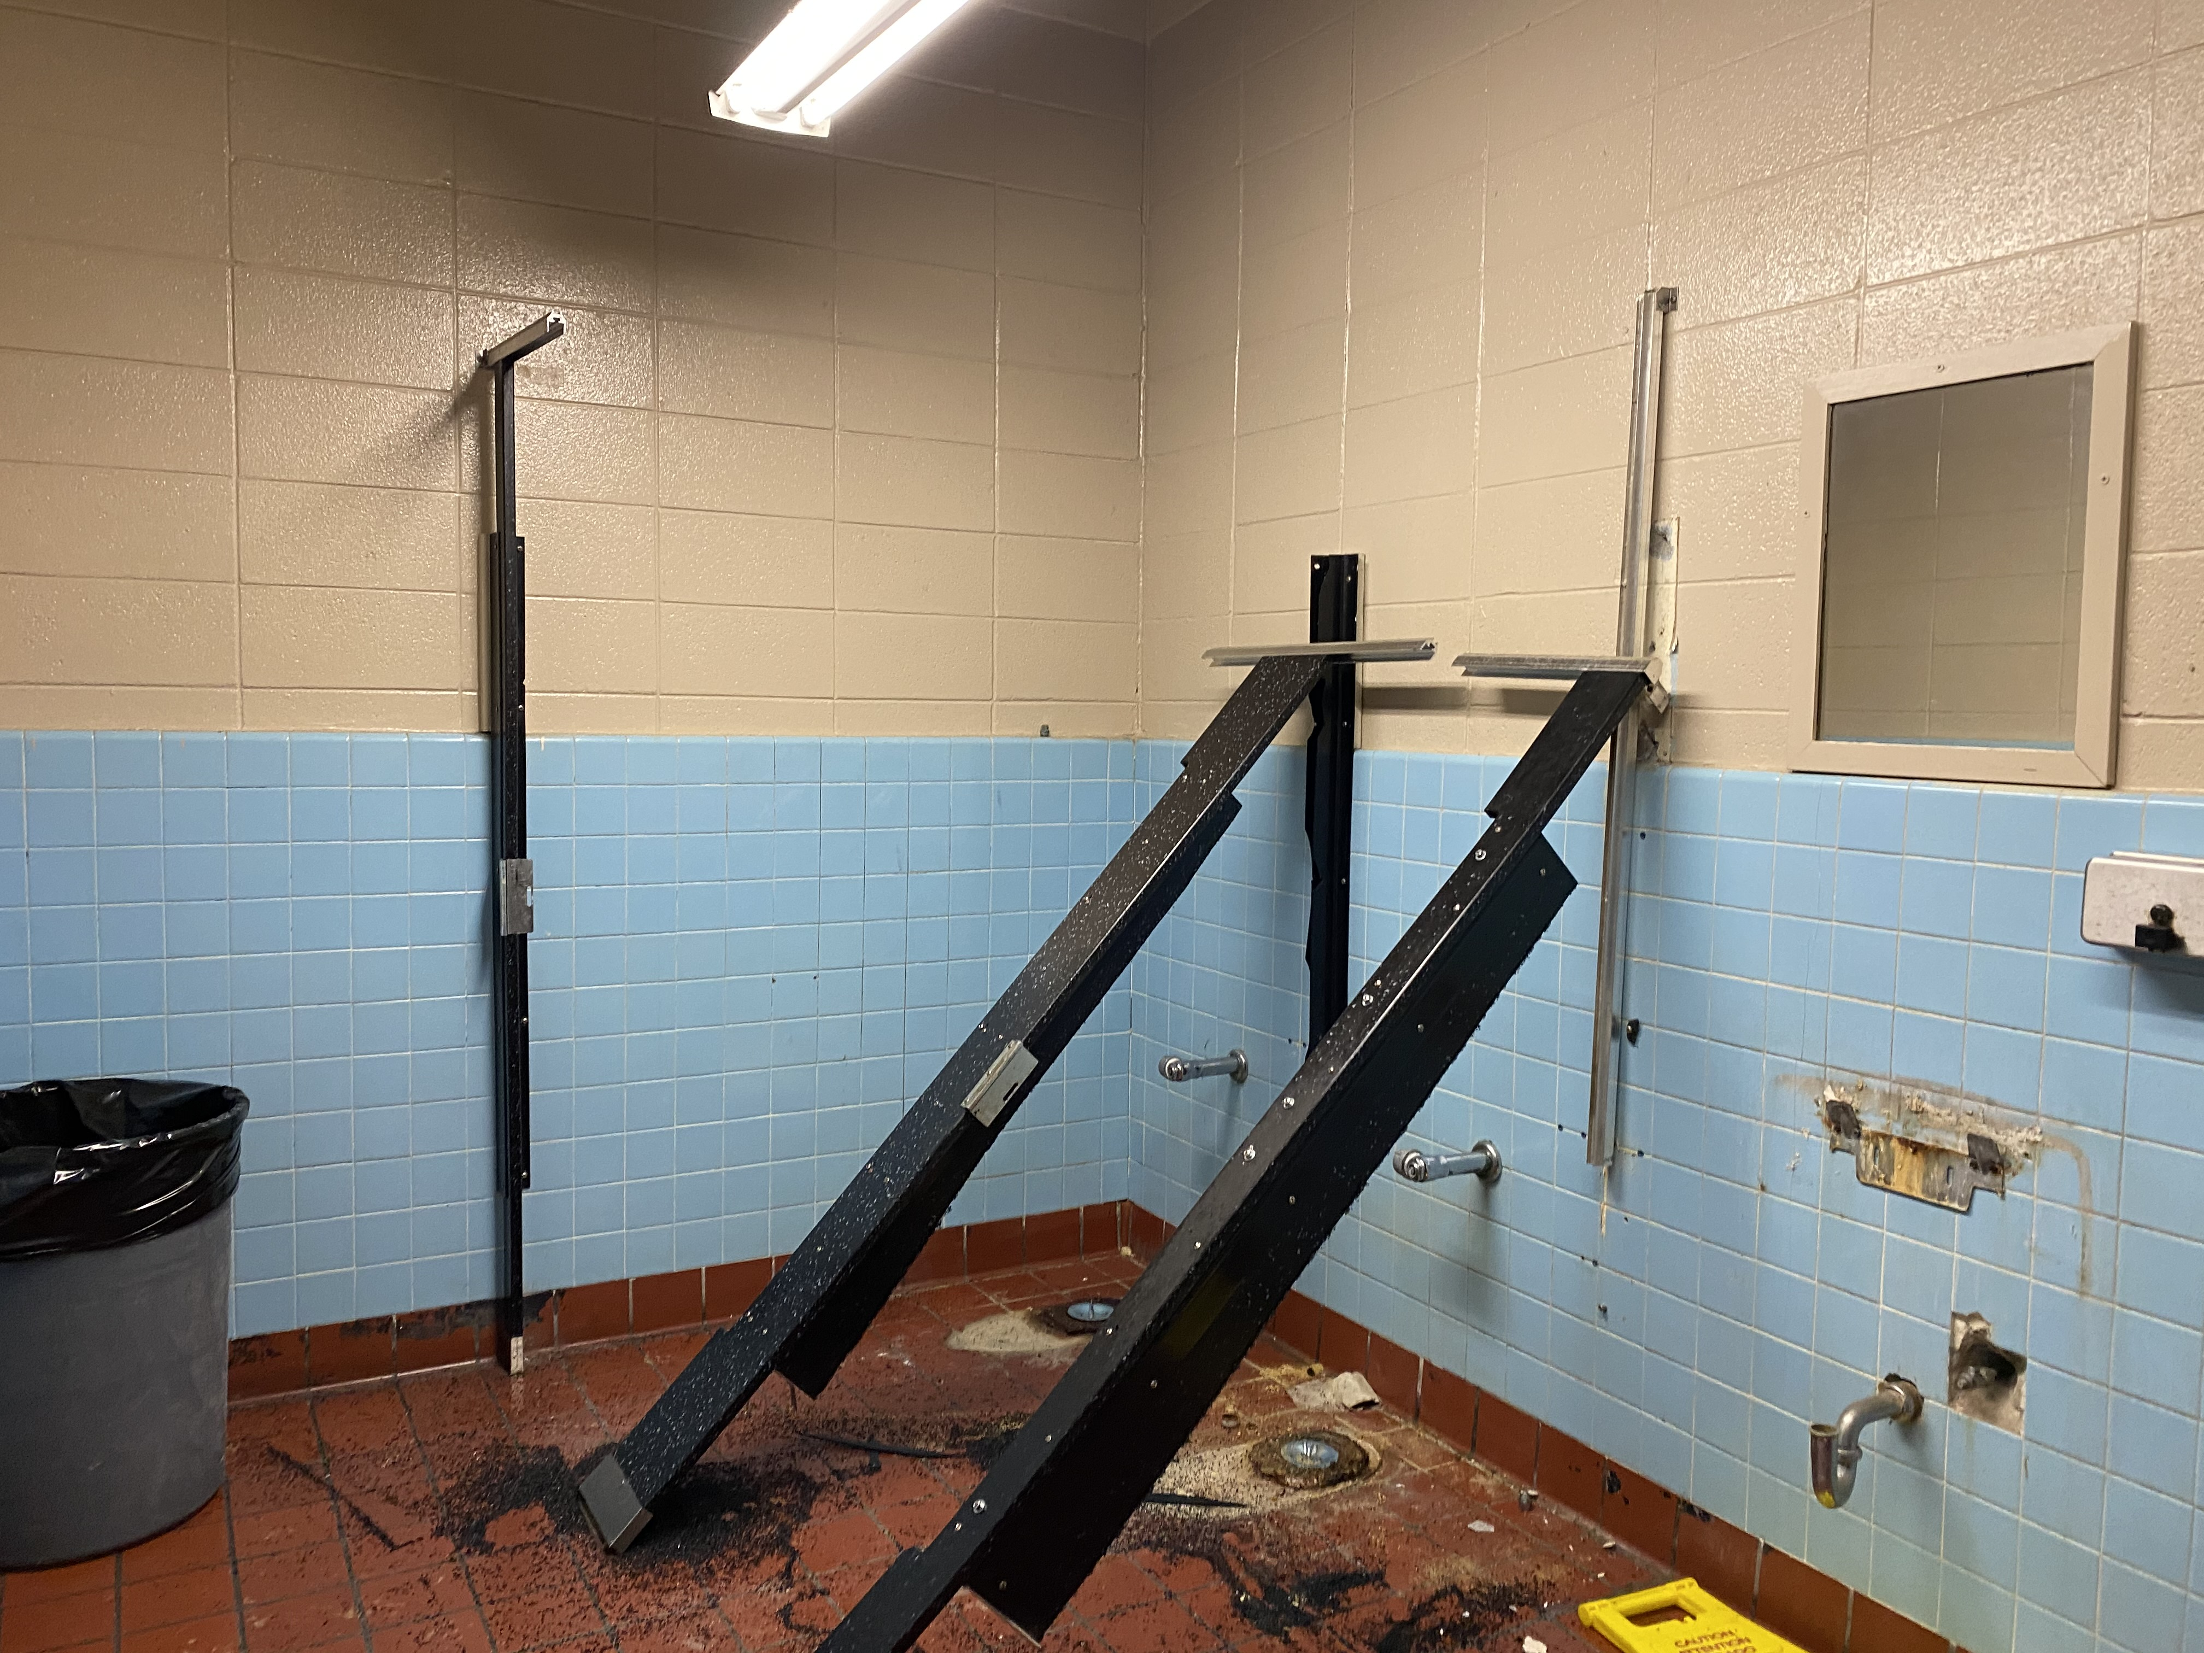
Oak Forest Elementary School
Restroom Renovations

Slide 9
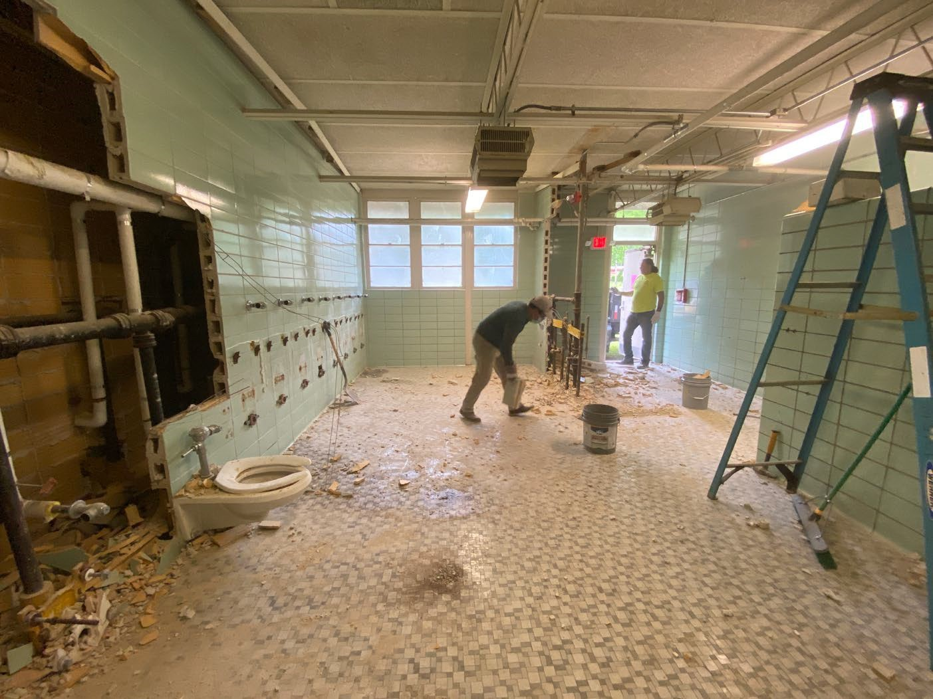
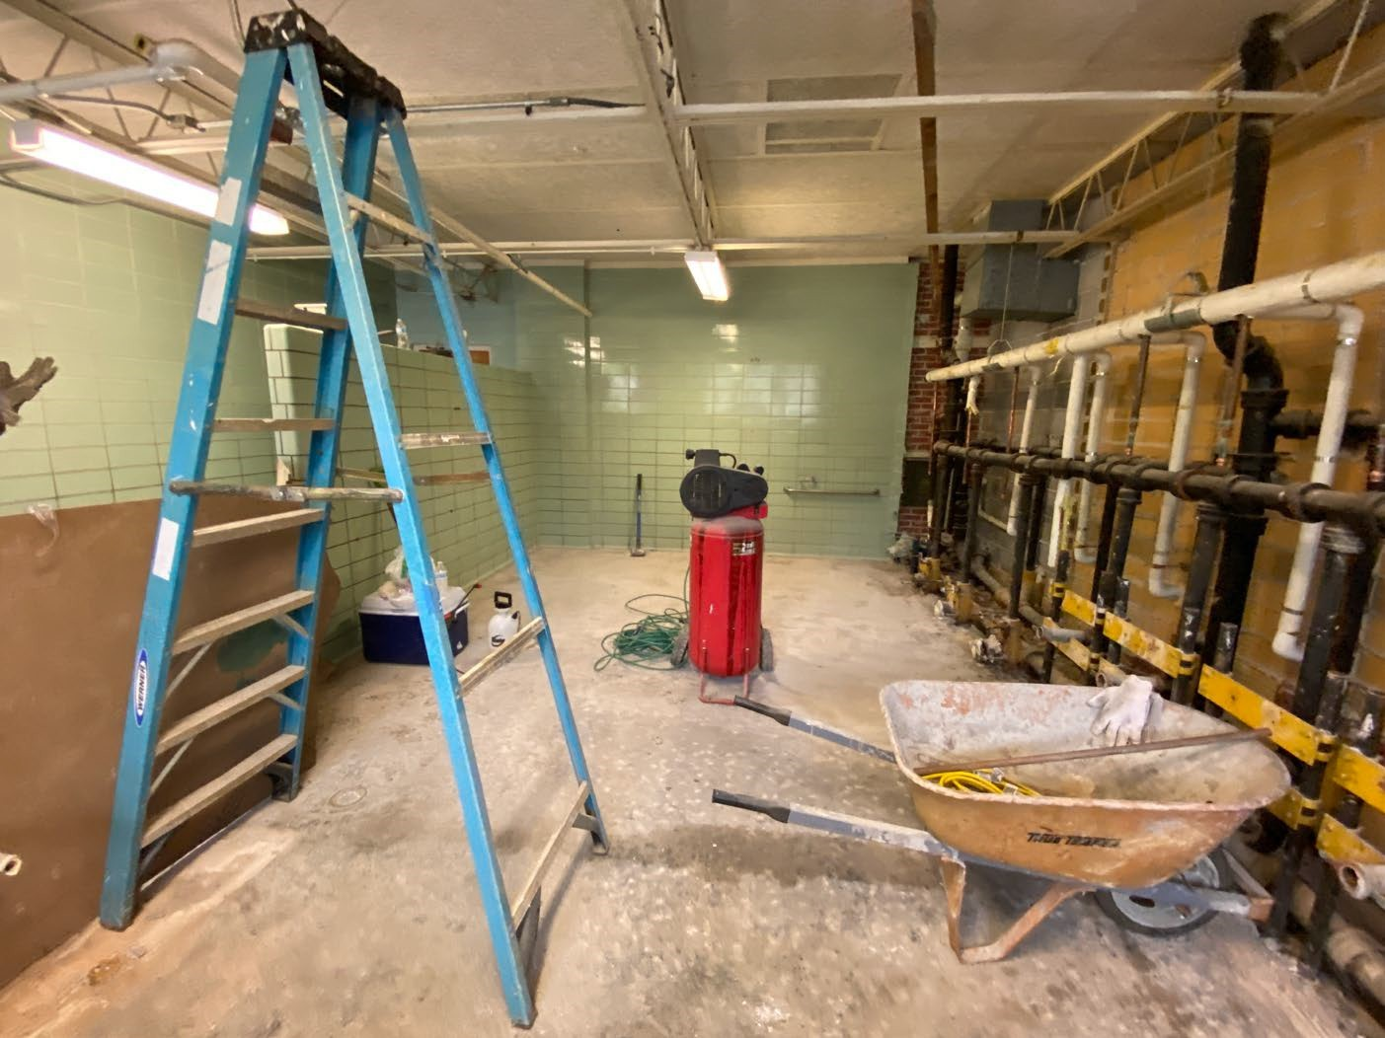
Shirley Elementary School
Restroom Renovations

Slide 10
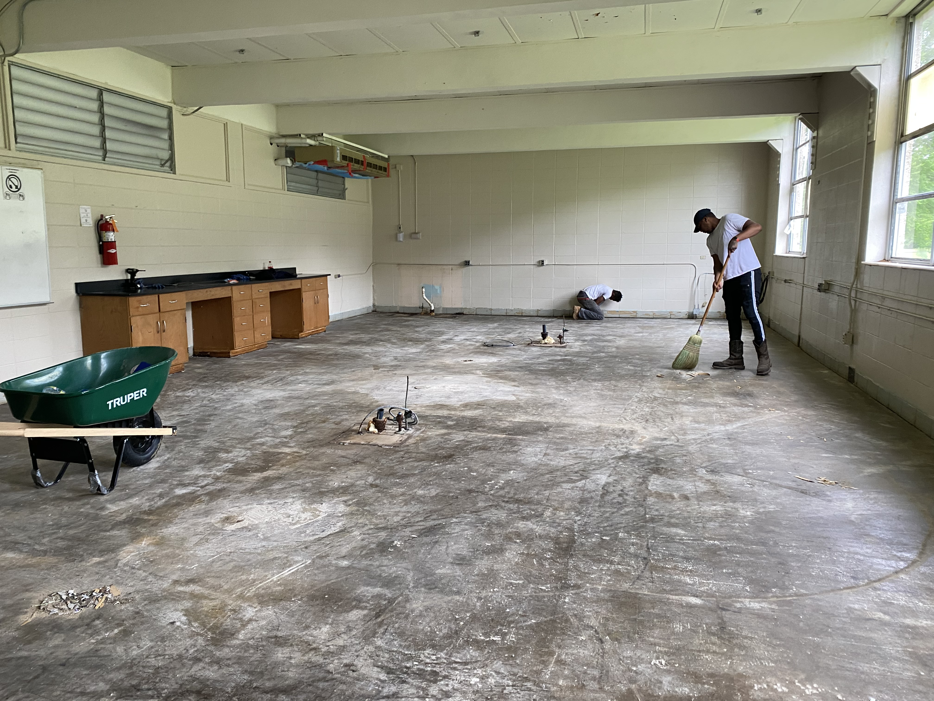
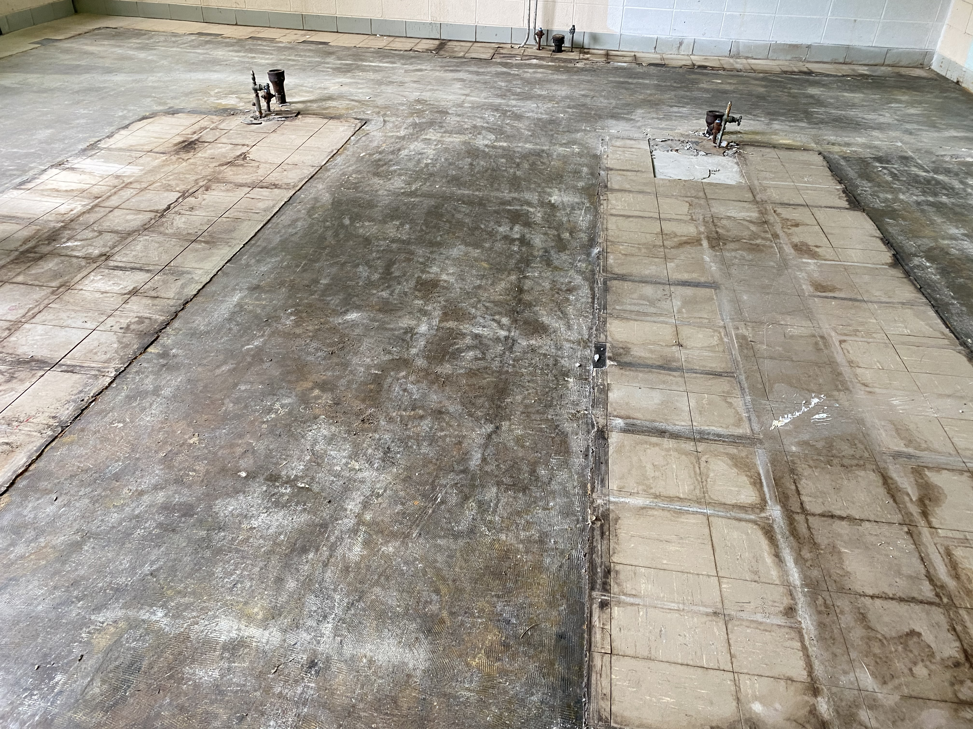
Brinkley Middle School
Science Lab Renovations

Slide 11
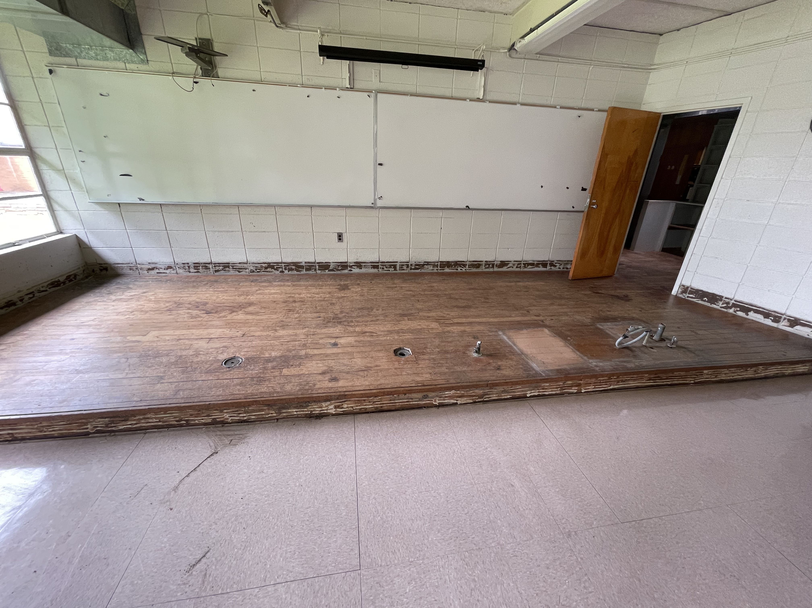
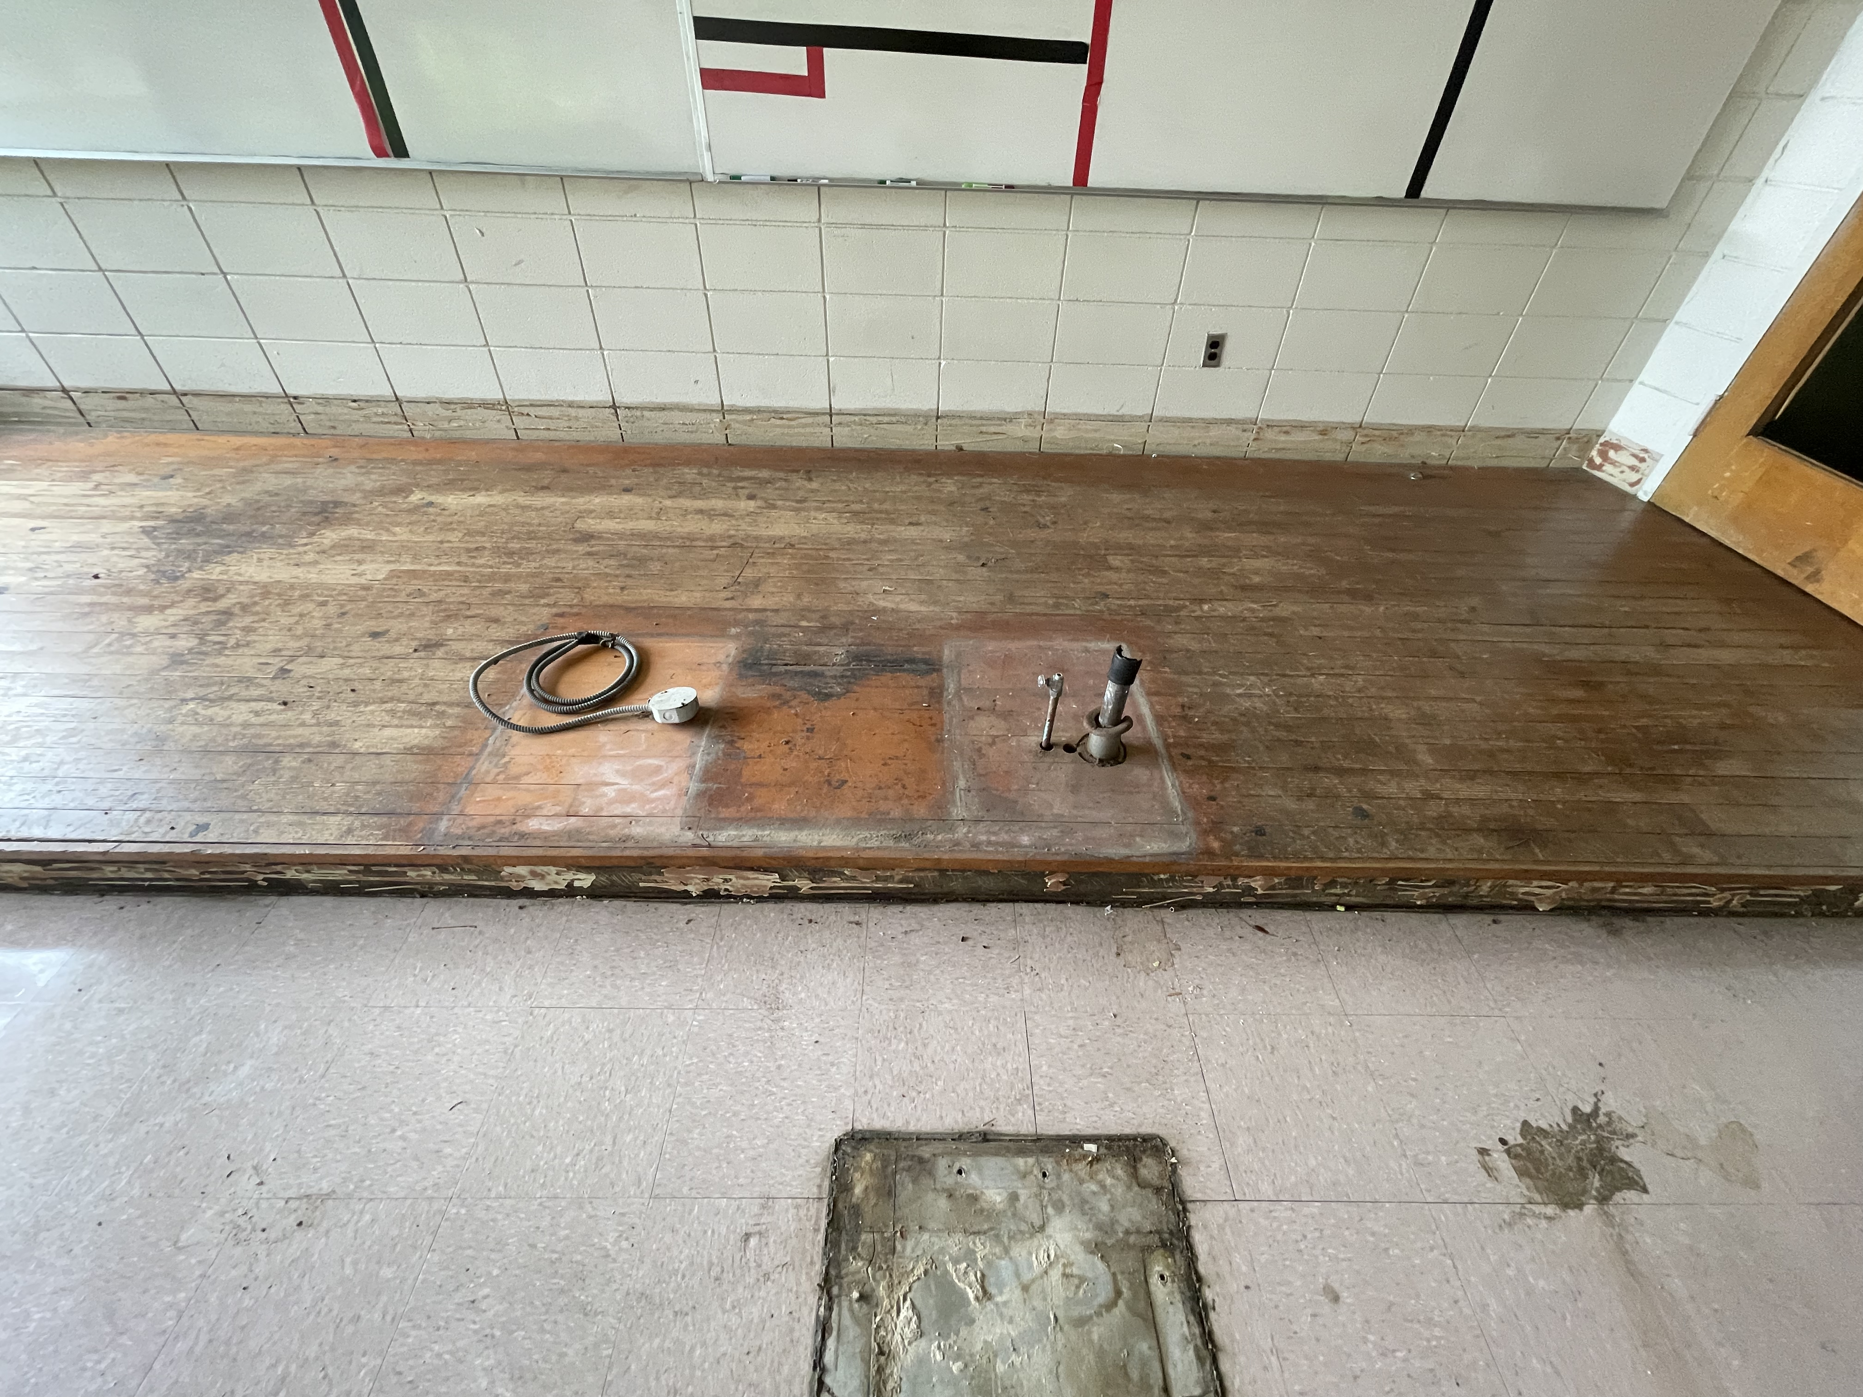
Chastain Middle School
Science Lab Renovations

Slide 12
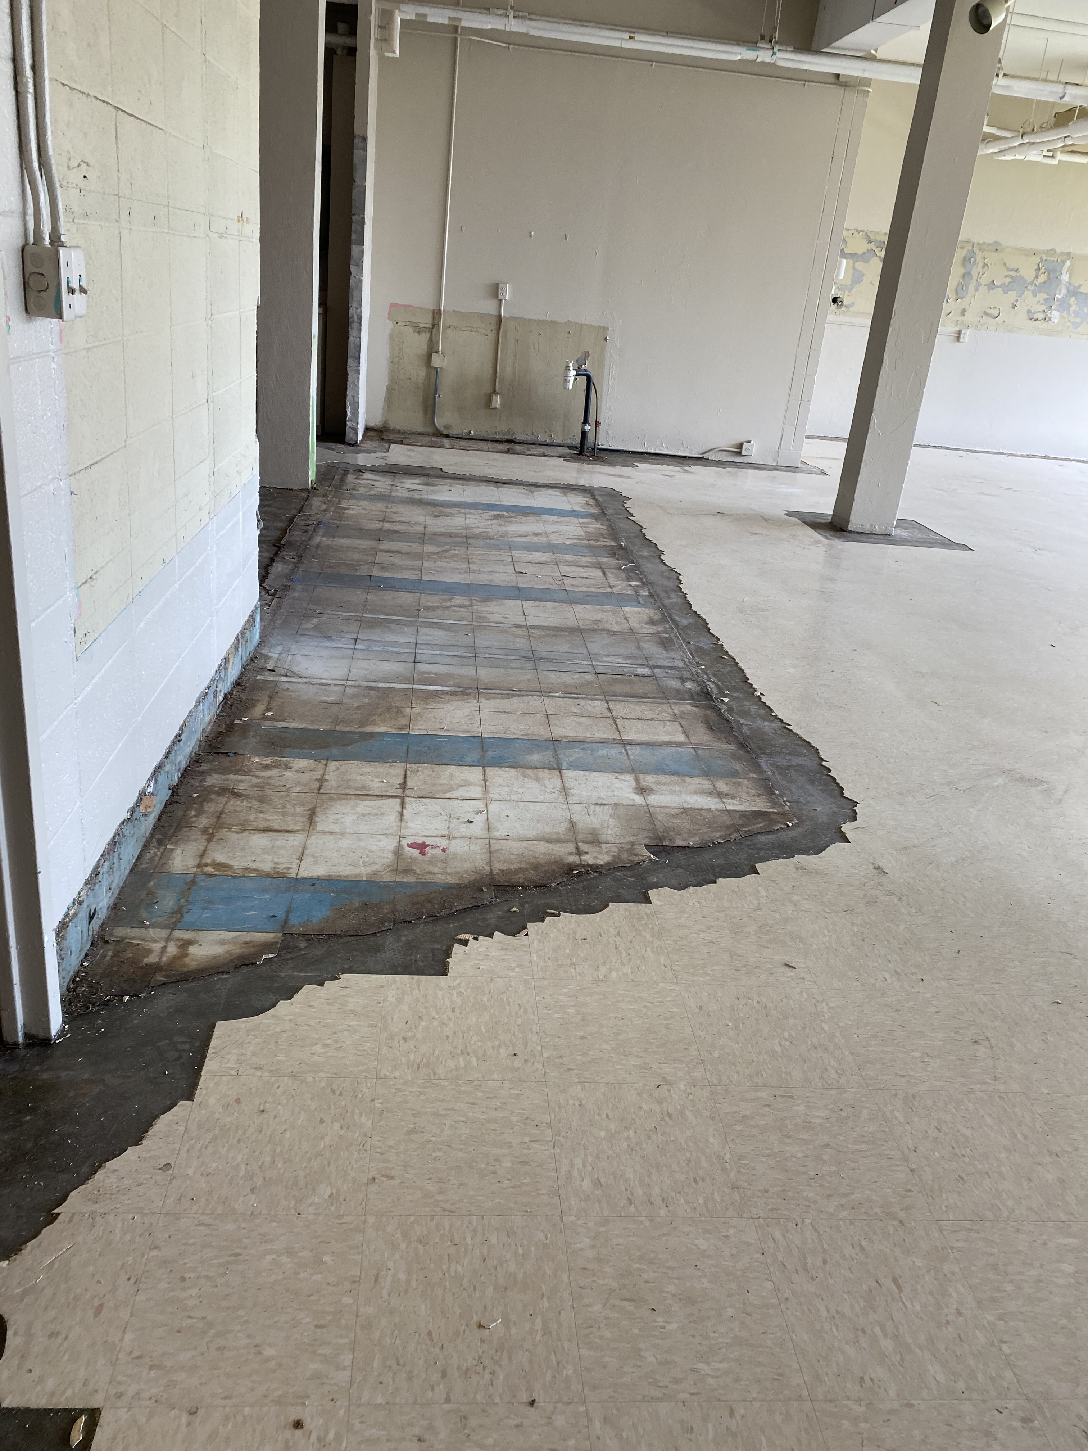
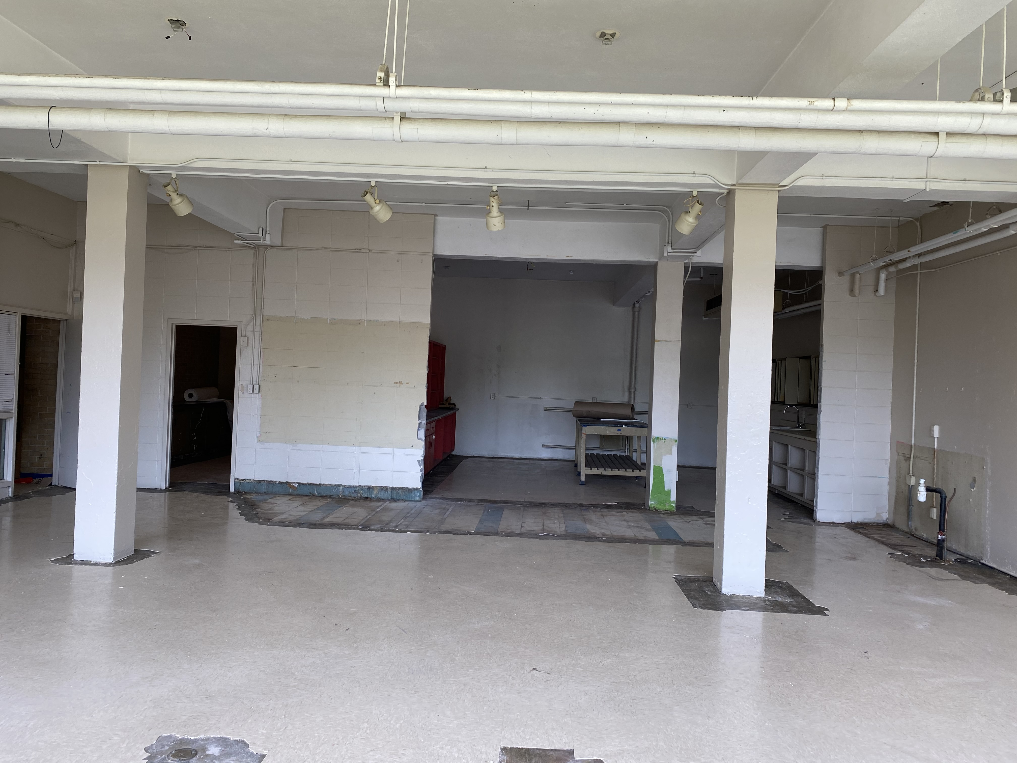
Powell Middle School
Science Lab Renovations

Slide 13
Summer Construction Sites
Elementary Schools
Baker
Boyd
Clausell
Dawson
Key
Lester
Marshall
North Jackson
Oak Forest
Shirley
Smith
Sykes
Walton
Wilkins
Middle Schools
Brinkley
Chastain
Hardy
Northwest
Peeples
Powell
Whitten
High Schools
Callaway
Capital City
Forest Hill
Lanier
Jim Hill
Murrah
Provine
Wingfield

Slide 14
Projected Board Action Timeline
Month | School /Major Projects
May 2021 | Forest Hill Performing Arts* Jim Hill Parking Lot Improvement* | Lanier Parking & JROTC Repairs* Lanier Window Restoration* Whitten Exterior Improvements
June 2021 | Bailey Structural Repairs* Hughes Field Renovations* Brinkley Renovations (Re-Bid) Johnson Structural Improvements | Lake Renovations Powell Renovations (Re-Bid) Raines Renovations
July 2021 | Chastain Renovations McLeod Renovations
* Denotes Phase I Schools/Projects

Slide 15
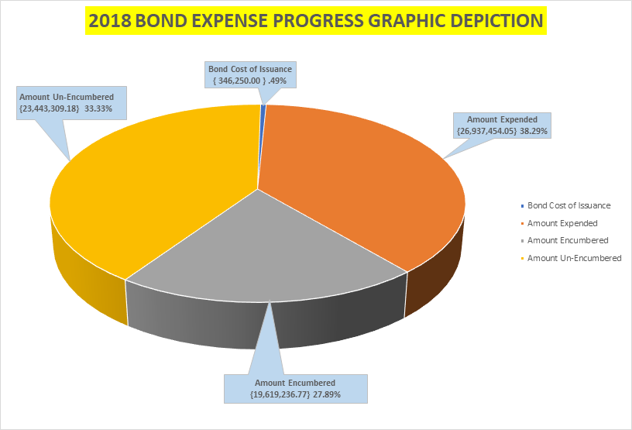
As of June 2, 2021: Amount “Expended + Encumbered” = 66%
Increase from 62% since last Bond Update; To Be Encumbered: $648,598.14

Slide 16
Bond Financial Update as of June 2, 2021

Slide 19
Bond Communications Update
Social Media School of the Week Highlight
Project Updates on School’s Webpage
WLBT News Segment

Slide 20
Thank You
We Welcome Any Questions

